Slide 1

MS SQL 2012 Database Administration Training by Sholla Corporation
8204 Fenton Street
Silver Spring, MD 20910

Slide 2
MS-SQL 2012 Database Administrator
Part II
Chapter III

Slide 3
MS-SQL 2012 Database …
Course Content :
Part II. MS SQL Database Design, Development and Administration
T-SQL Programming

Slide 4
TSQL
In 1970's the product called 'SEQUEL', structured English query language, developed by IBM and later SEQUEL was renamed to 'SQL' which stands for Structured Query Language.
In 1986, SQL was approved by ANSI (American national Standards Institute) and in 1987, it was approved by ISO (International Standards Organization).
SQL is a structured query language which is a common database language for all RDBMS products. Different RDBMS product vendors have developed their own database language by extending SQL for their own RDBMS products.
T-SQL stands for Transact Structure Query Language which is a Microsoft product and is an extension of SQL Language.
Example
MS SQL Server - SQL\T-SQL
ORACLE - SQL\PL-SQL

Slide 5
Data types
SQL server stores data in a table (the table is defined by column)
Each raw in sql server is data (actual data)
SQL Server data type is an attribute that specifies types of data of any object.
Each column, variable and expression has related data type in SQL Server.
These data types can be used while creating tables.
You can choose a particular data type for a table column based on your requirement.
SQL Server offers seven categories including other category of data types for use.

Slide 6
Data Type:
Exact Numeric Types
Type | From | To
bigint | -9,223,372,036,854,775,808 | 9,223,372,036,854,775,807
int | -2,147,483,648 | 2,147,483,647
smallint | -32,768 | 32,767
tinyint | 0 | 255
bit | 0 | 1
decimal | -10^38 +1 | 10^38 –1
numeric | -10^38 +1 | 10^38 –1
money | -922,337,203,685,477.5808 | +922,337,203,685,477.5807
smallmoney | -214,748.3648 | +214,748.3647

Slide 7
Data Type:
Approximate Numeric Types
Date and Time Types
Type | From |  | To
Float | -1.79E + 308 | 1.79E + 308
Real | -3.40E + 38 | 3.40E + 38
Type | From | To
datetime (3.33 milliseconds accuracy) | Jan 1, 1753 | Dec 31, 9999
smalldatetime (1 minute accuracy) | Jan 1, 1900 |  | Jun 6, 2079
date (1 day accuracy) | Jan 1, 0001 |  | Dec 31, 9999
datetimeoffset (100 nanoseconds accuracy) | Jan 1, 0001 |  | Dec 31, 9999
datetime2 (100 nanoseconds accuracy) | Jan 1, 0001 |  | Dec 31, 9999
time (100 nanoseconds accuracy) | 00:00:00.0000000 |  | 23:59:59.9999999

Slide 8
Data Type:
Character Strings
Unicode Character Strings
Type | Description
char | Fixed-length non-Unicode character data with a maximum length of 8,000 characters.
varchar | Variable-length non-Unicode data with a maximum of 8,000 characters.
Varchar (max) | Variable-length non-Unicode data with a maximum length of 2³¹ characters
text | Variable-length non-Unicode data with a maximum length of 2,147,483,647 characters.
Type | Description
nchar | Fixed-length Unicode data with a maximum length of 4,000 characters.
nvarchar | Variable-length Unicode data with a maximum length of 4,000 characters.
Nvarchar (max) | Variable-length Unicode data with a maximum length of 2³⁰ characters
ntext | Variable-length Unicode data with a maximum length of 1,073,741,823 characters.

Slide 9
Data Type:
Binary Strings
Other Data Types
sql_variant: Stores values of various SQL Server-supported data types, except text, ntext, and timestamp.
timestamp: Stores a database-wide unique number that gets updated every time a row gets updated.
uniqueidentifier: Stores a globally unique identifier (GUID).
xml: Stores XML data. You can store XML instances in a column or a variable
cursor: A reference to a cursor.
table: Stores a result set for later processing.
hierarchyid: A variable length, system data type used to represent position in a hierarchy
Type | Description
binary | Fixed-length binary data with a maximum length of 8,000 bytes.
varbinary | Variable-length binary data with a maximum length of 8,000 bytes.
varbinary(max) | Variable-length binary data with a maximum length of 2³¹ bytes
image | Variable-length binary data with a maximum length of 2,147,483,647 bytes.

Slide 10
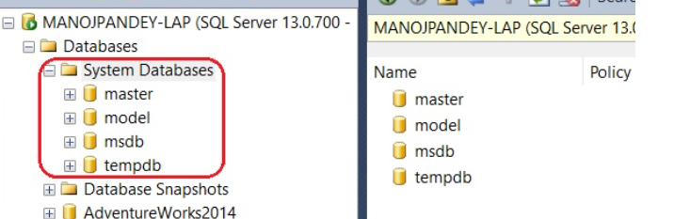
The MSSQL Server System Database vs User Databases
MSSQLSERVER: when ever you install MSSQL server database engine, the install comes with system databases (called master, msdb, model and temp db) .
User databases: Any database created by user in SQL SERVER.

Slide 11
System Databases
Master: contains all of the system level information for SQL Server – all of the logins, linked servers, endpoints, and other system-wide configuration settings…
Model: database is used as the template for all databases created on an instance of SQL Server. The entire contents of the model database, including database options, are copied to the new database. Thus, if you modify the model database, all databases created afterward will inherit those changes.
MSDB: database is used by SQL Server Agent for scheduling alerts and jobs and by other features such as SSMS, Service Broker and Database Mail.
Tempdb: database is a workspace for holding temporary objects or intermediate result sets. Tempdb is re-created every time SQL Server is started so that the system always starts with a clean copy of the database.

Slide 12
SQL Environment
Language – there are four types of TSQL languages
Data Definition Language (DDL)
Data Manipulation Language (DML)
Data Control Language (DCL)
Transaction Control Language (TCL)

Slide 13
SQL Environment
Data Definition Language (DDL)
Is the SQL commands that can be used to define the database schema.
It simply deals with descriptions of the database schema and is used to create and modify the structure of database objects in database.
Examples of DDL commands:
CREATE – is used to create the database or its objects (like table, index, function, views, store procedure and triggers).
DROP – is used to delete objects from the database.
ALTER-is used to alter the structure of the database.
TRUNCATE–is used to remove all records from a table, including all spaces allocated for the records are removed.
COMMENT –is used to add comments to the data dictionary.
RENAME –is used to rename an object existing in the database

Slide 14
SQL Environment
Data Manipulation Language (DML)
Is SQL commands that deals with the manipulation of data present in database belong to DML or Data Manipulation Language and this includes most of the SQL statements.
Examples of DML:
SELECT – is used to retrieve data from the a database.
INSERT – is used to insert data into a table.
UPDATE – is used to update existing data within a table.
DELETE – is used to delete records from a database table.

Slide 15
SQL Environment
Data Control Language (DCL)
includes commands such as GRANT and REVOKE which mainly deals with the rights, permissions and other controls of the database system.
Examples of DCL commands:
GRANT-gives user’s access privileges to database.
REVOKE-withdraw user’s access privileges given by using the GRANT command.

Slide 16
SQL Environment
Transaction Control Language (TCL)
the commands deals with the transaction within the database.
Examples of TCL commands:
COMMIT– commits a Transaction.
ROLLBACK– rollbacks a transaction in case of any error occurs.
SAVEPOINT–sets a save point within a transaction.
SET TRANSACTION–specify characteristics for the transaction.

Slide 17
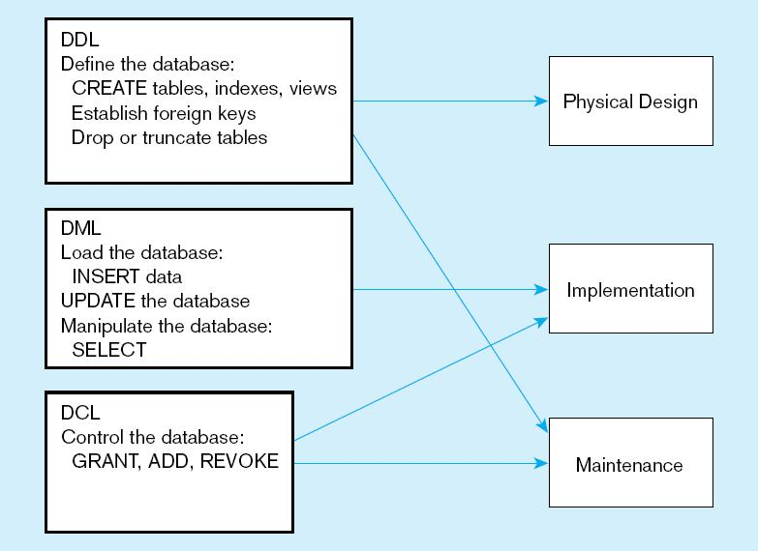
DDL, DML, DCL, and the database development process

Slide 18
DDL (Data Definition Language
Create Database Sholla_Student
Create Database [YOUR_FNAME]_Student
Create Database [YOUR_LNAME]_Student
Drop database Sholla_Student
Drop database [YOUR_FNAME]_Student
Drop database [YOUR_LNAME]_Student

Slide 19
Primary Key and Foreign Key
The PRIMARY KEY constraint uniquely identifies each record in a database table.
Primary keys must contain UNIQUE values, and cannot contain NULL values.
A table can have only one primary key, which may consist of single or multiple fields
A FOREIGN KEY is a key used to link two tables together.
A FOREIGN KEY is a field (or collection of fields) in one table that refers to the PRIMARY KEY in another table.
The table containing the foreign key is called the child table, and the table containing the candidate key is called the referenced or parent table.

Slide 20
Table and its data type
Note: the difference
b/n Nchar and Nvarchar
Course
Registration_Master
Instructor_Master
Course# NVarchar(9) | Course_Name NVarchar(50) | Credit_hour Int | Contact_Hr int
144 | SQL Amin | 8 | 8
144 | SQL Amin | 8 | 8
144 | SQL Amin | 8 | 8
Reg# Int | REgDate (datetime) | Std_ID Int | Course# NVarchar(9) | Inst_ID Nvarchar(50)
01101 |  | 001 | 144 | 035
01102 |  | 003 | 144 | 035
01103 |  | 003 | 144 | 035
Inst_ID Nvarchar(50) | Inst_F_name Nvarchar (50) | Inst_Lname Nvarchar(50) | Inst_Primary_Phne Int | Inst_Primary_email Nvarchar(100)
035 | Peter | Sima | 32546544 | Peter…
035 | Peter | Sima | 32546544 | Peter…
035 | Peter | Sima | 32546544 | Peter…
Student_Master
Instructor_Address
Std_ID int | F_Name Nvarchar (50) | M_Name Nvarchar(1) | L_Name Nvarchar (50)
001 | Maya | Z | Max
002 | Alex | B | Ben
003 | Del | H | Adam
Inst_ID Nvarchar(50) | S_Adds Nvarhar(100) | City nvarchar (2) | Zip Int
001 | 1234 N F | xxx | 001
002 | 324 DT | xxx | 035
003 | 3231 kl | xxx | 112
Student_Address
Std_ID int | Primary_ Email Nvarchar (100) | Secondary_Emial Nvarchar (100) | Primary_Phone int | Secondary_ Phone int
001 | 0012112122 | 111@gg.c | 22222222 | 333333
002 | 01325465 | 11231@g.c | 1111111 | -
003 | 011234598 | lkl@eu.net | 5655412 | -

Slide 21
Create Database and Table
Create Database Peter_Database
Create Table Student
(Std_id int not null Primary Key,
F_name NVarchar(50) Not null,
M_name Nvarchar(1) null,
L_name Nvarchar(50) not null)
Create Table Instructor_Master
(Inst_id Nvarchar(50) not null,
Inst_F_name Nvarchar(50)not null,
Inst_L_name Nvarchar(50) not null,
Inst_Primary_Phone Int not null,
Inst_Primary_Emial Nvarchar(100) not null
Primary key (inst_id))
Create Table Course
(Course# Nvarchar(90) not null Primary Key,
Course_Name Nvarchar(50) not null,
Credit_hour int not null,
Contact_hour int not null)
Create Table Registration
(Reg# int not null Primary Key,
Reg_Date Datetime not null,
Std_id int not null Foreign Key references Student(Std_id),
Coure# Nvarchar(9) not null Foreign Key references Course (Course#),
Inst_Id Nvarchar(50) not null Foreign Key references Instructor_Master(Inst_id)

